Slide 1
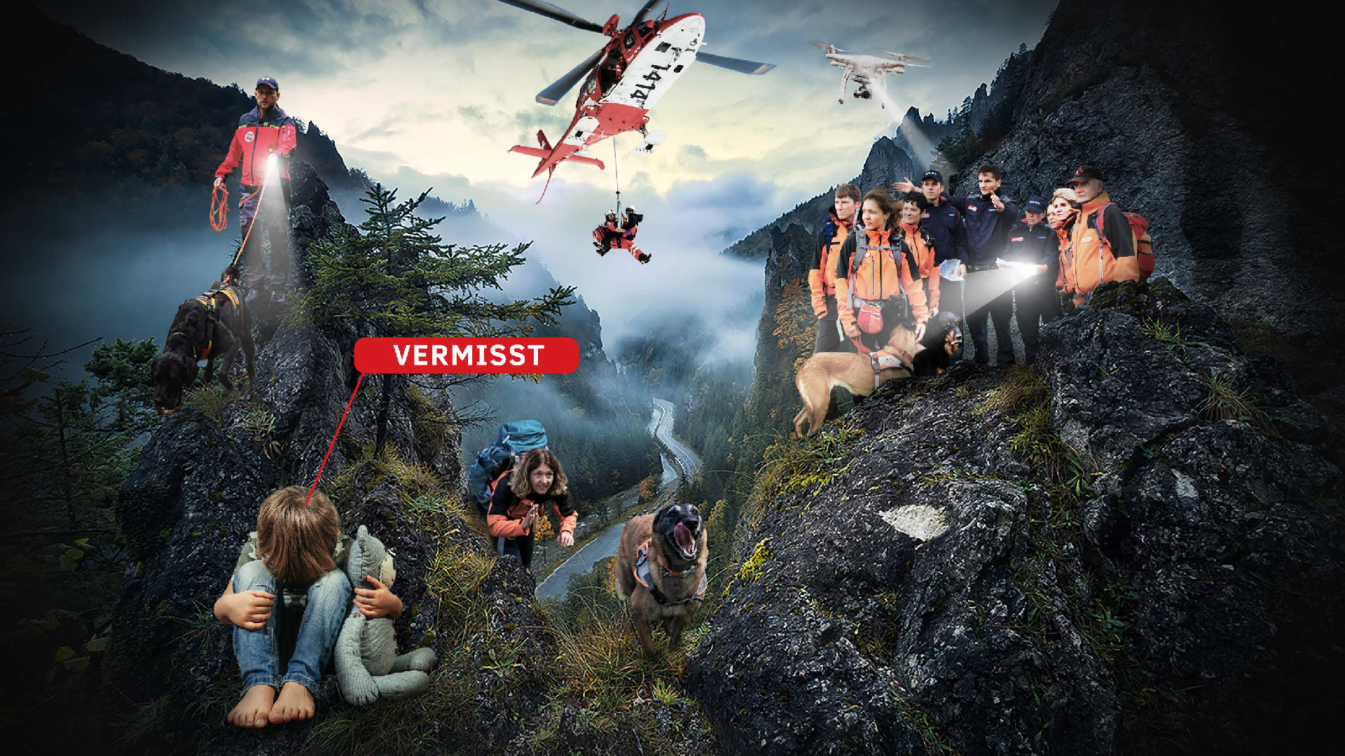
certaid – connecting help seekers and helpers

Slide 2
Um was geht es? / What is it about?
Challenge target: Prototype of the „scenariofinder“
Questions to identify the problem situation → what kind of help is needed?
Find the matching scenario from the database → what kind of scenario is matching?
Identify the needed helpers based on the scenario and the helper-database → which helpers are necessary
With the «scenariofinder» we can find the right helpers in less time!
Notes:
2

Slide 3
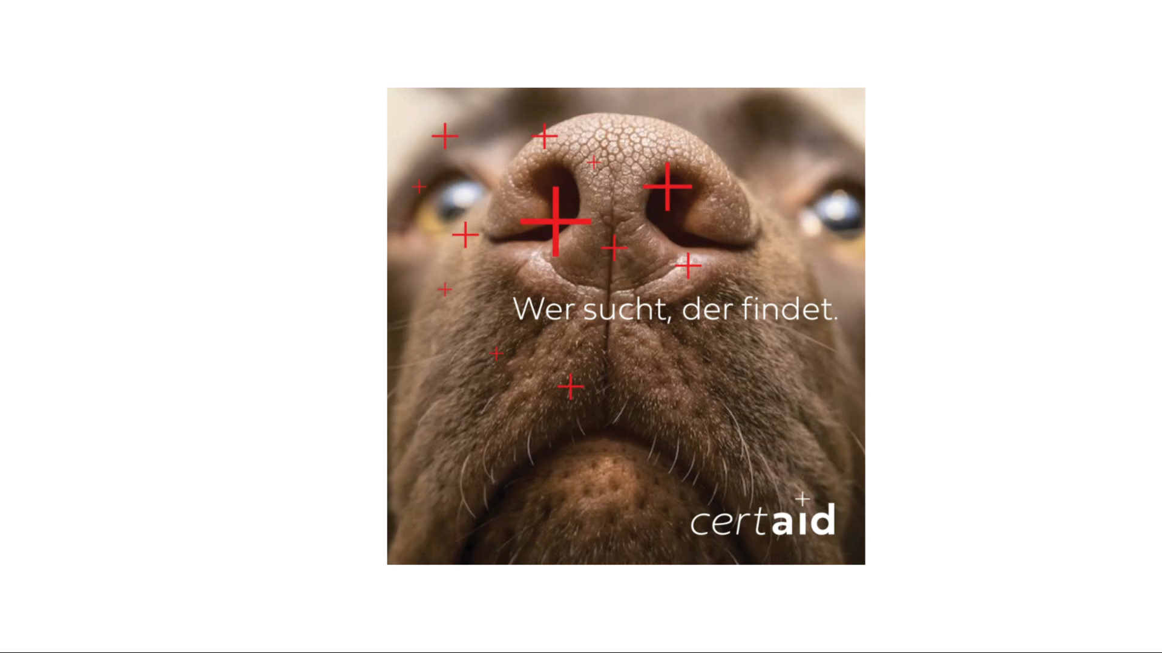
Solution demo: Chatbot for request from help seekers

Slide 4
Um was geht es? / What is it about?
Challenge target: Prototype of the „scenariofinder“
Questions to identify the problem situation → what kind of help is needed?
Find the matching scenario from the database → what kind of scenario is matching?
Identify the needed helpers based on the scenario and the helper-database → which helpers are necessary
With the «scenariofinder» we can find the right helpers in less time!
Notes:
4

Slide 5
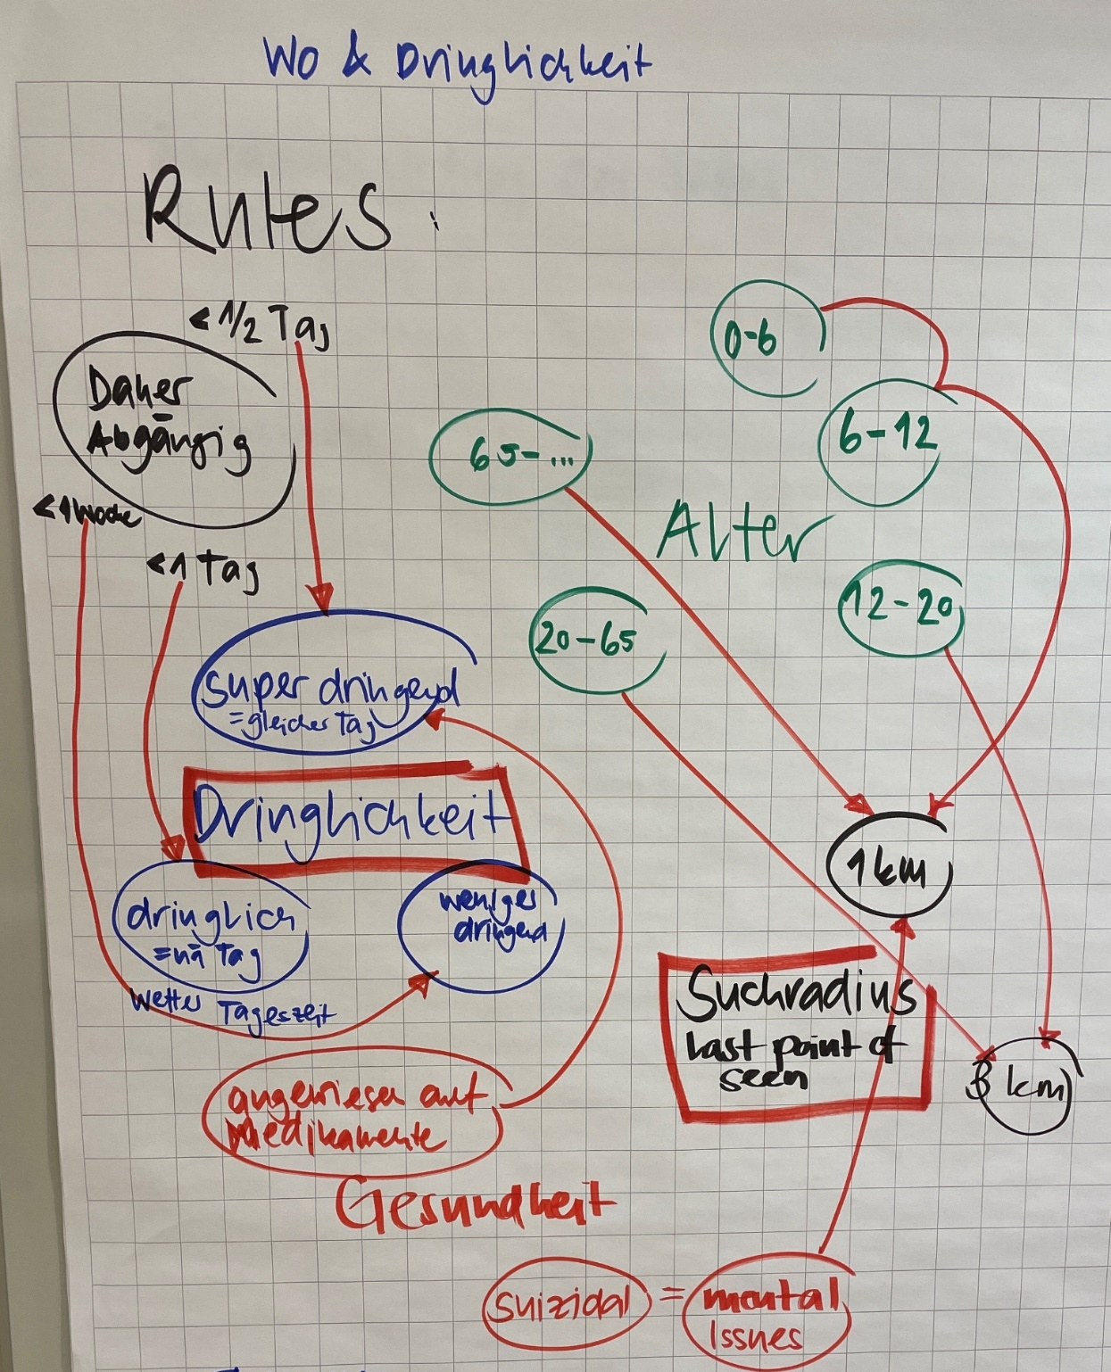
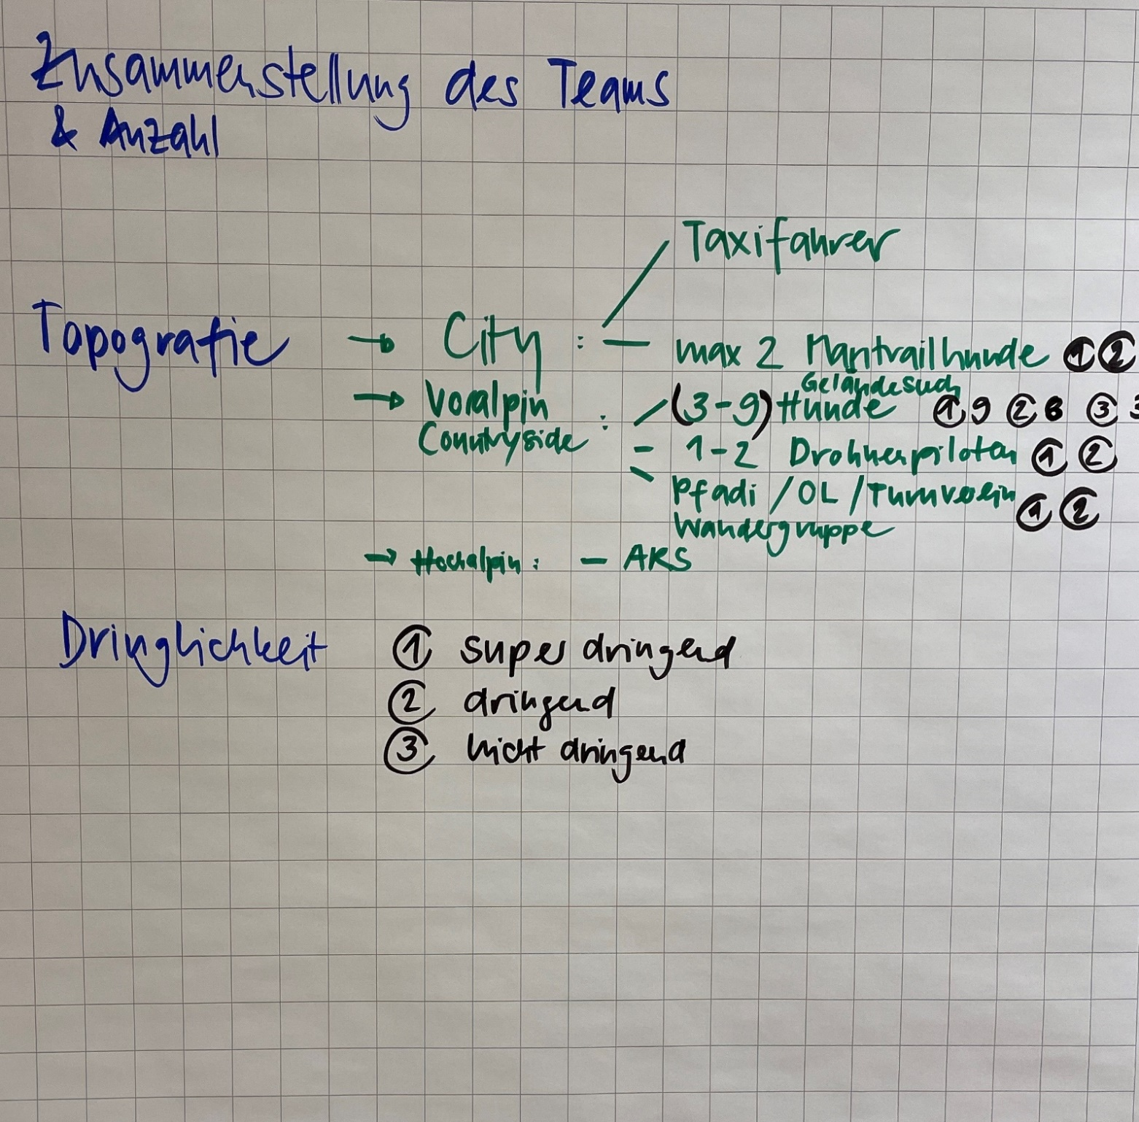
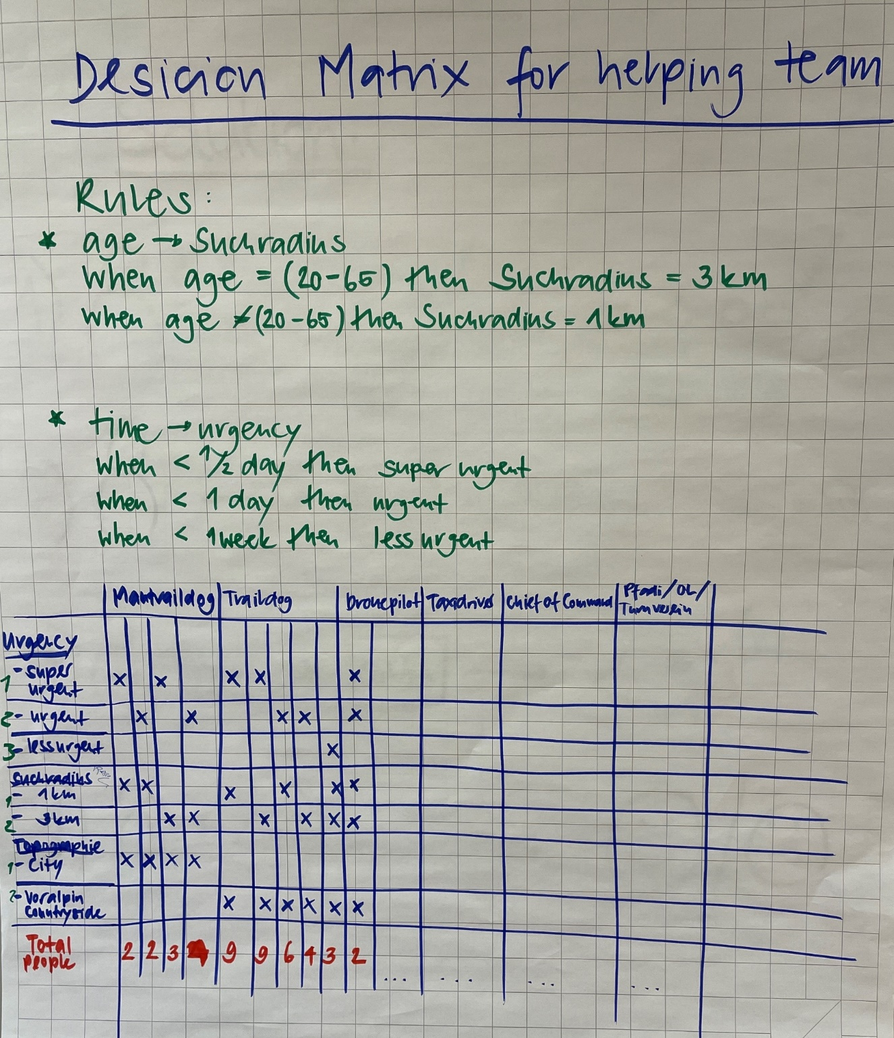
Solution Demo: Matching Data for Decision

Slide 6

Solution demo: Matching Data for Decision

Slide 7
Learnings
Every year, 5000 people go missing in Switzerland. Every person found is a success!
Chatbot and Decisionmaker was built in the last hours
certaid will continue to use the prototypes to find investors to further develop their project. More scenarios to place volunteers will follow.
Complexity is higher than expected.
Our Teamwork: Interdisciplinary teams are successful, pleasant cooperation, if someone with the required skills is missing, progress is blocked.

